Slide 1

KAREL THE ROB T
CS114 – Intro to Software Engineering
Presentation By
Ryan Flaherty
Jing Mingh
Chris Amarello

Slide 2
Karel the Robot - Overview
Key Goals
One Key Accomplishment / Technique
What We Learned Working in a Group
Looking Forward & Summary

Slide 3
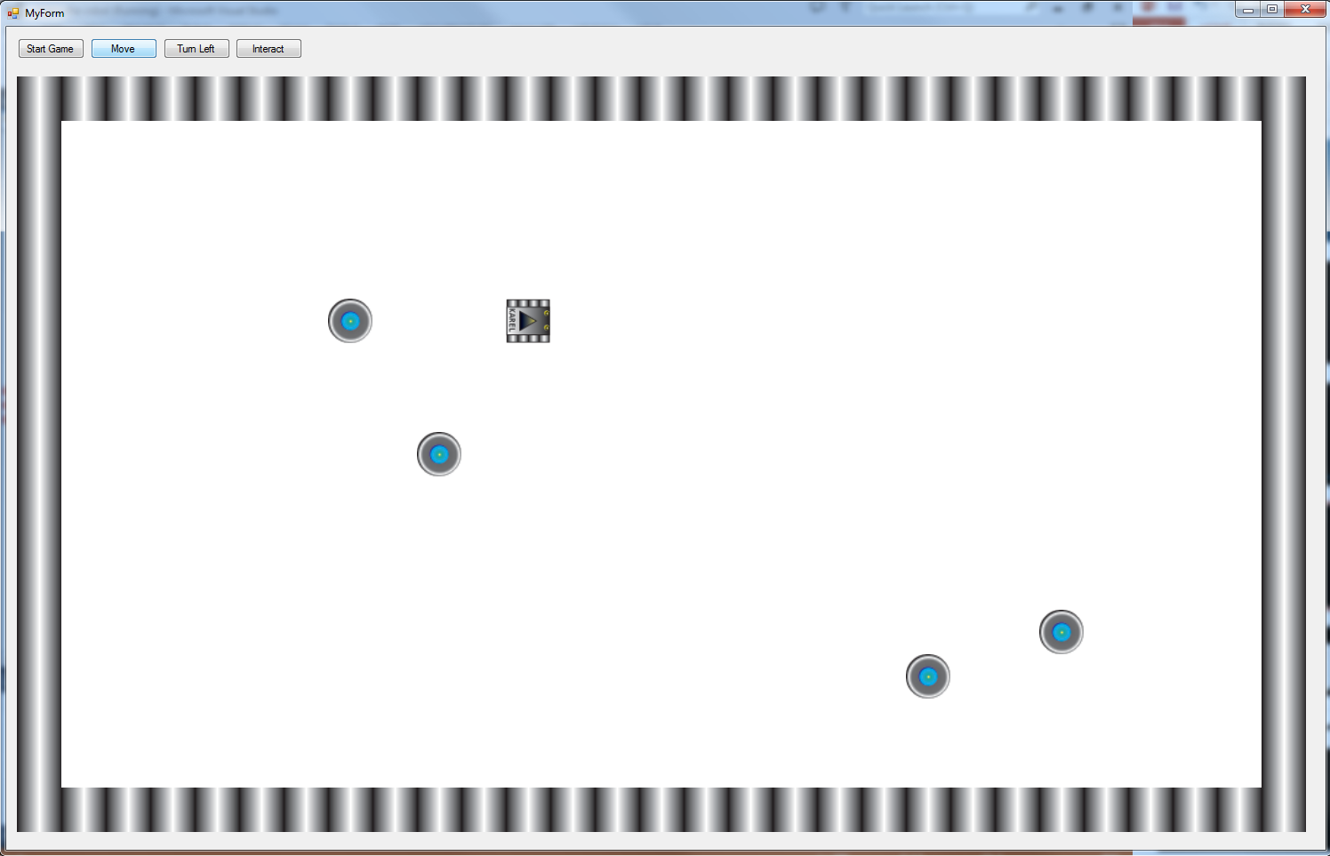





Key Goals
Creating Karel’s World
Graphics
Beepers
Walls
Robot
Double Buffering
KarelRight.bmp
KarelLeft.bmp
KarelDown.bmp
KarelUp.bmp
KarelWallBlock.bmp
KarelBeeper.bmp

Slide 4
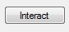
One Key Accomplishment / Technique
Beepers
“Interact”
Pick-Up, Inventory, Drop

Slide 5
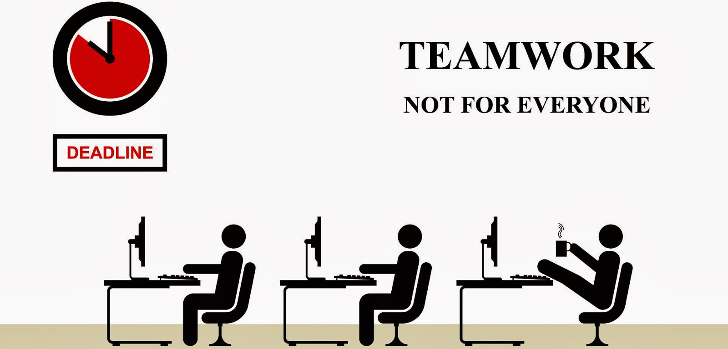
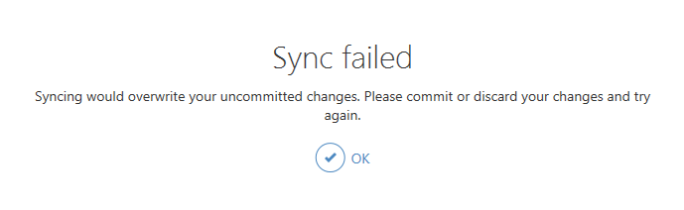

What We Learned Working in a Group
Specified Roles
Programmers
Ryan Flaherty
Jing Mingh
Artist
Chris Amarello
GitHub
Team Sync Fails
Merged Corrupt Files
Have Back-Ups!!

Slide 6
Looking Forward & Summary
Looking Forward
Learning to Work In Group
Make awesome programs & games
Summary
Key Goals
One Key Accomplishment / Technique
What We Learned Working in a Group

